Slide 1






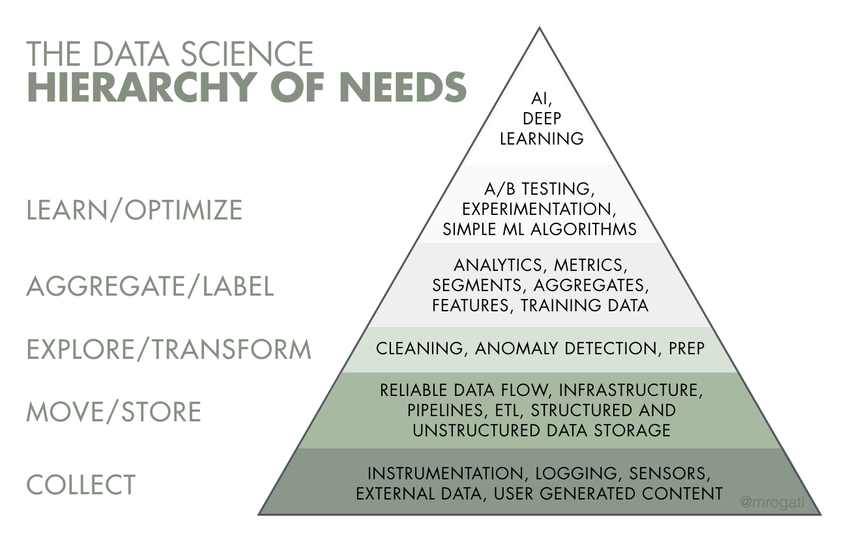
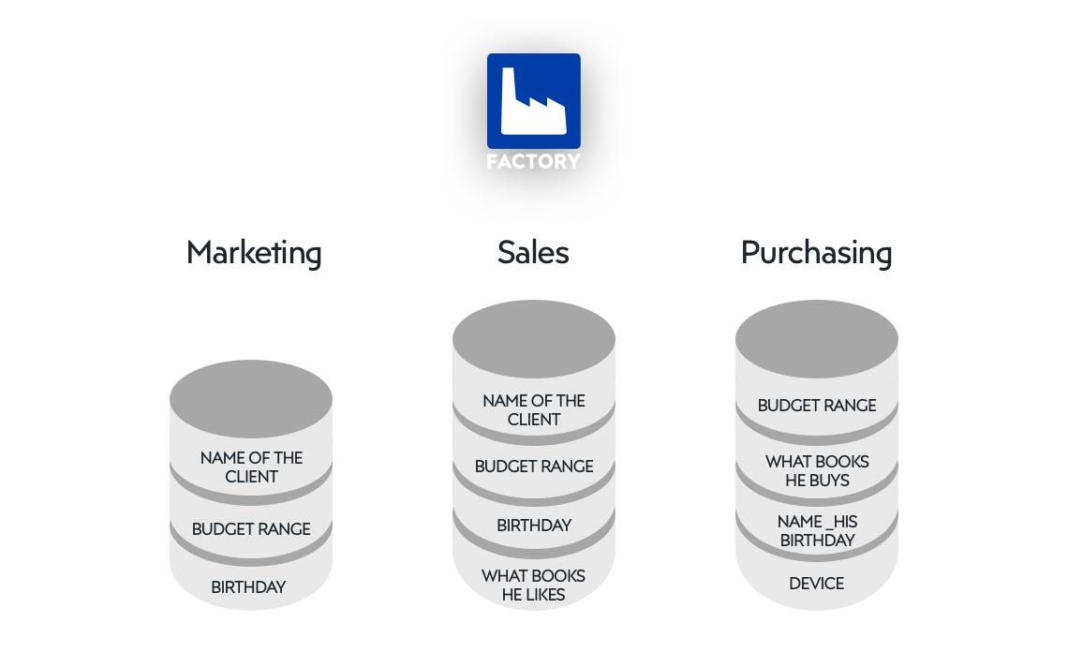








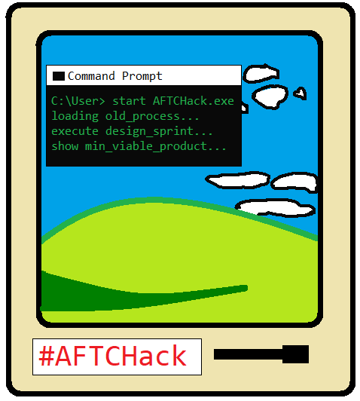



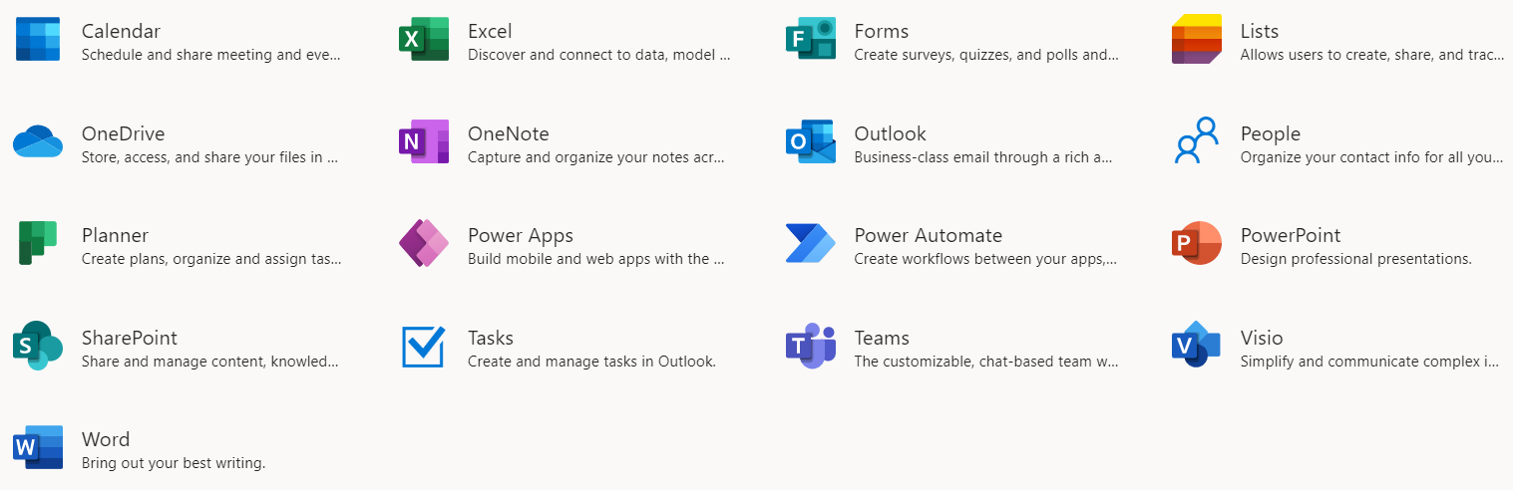
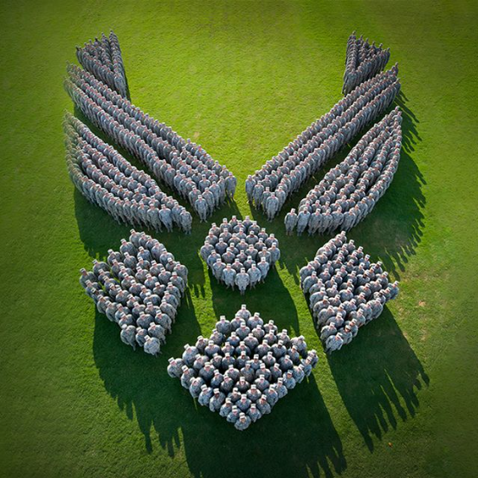

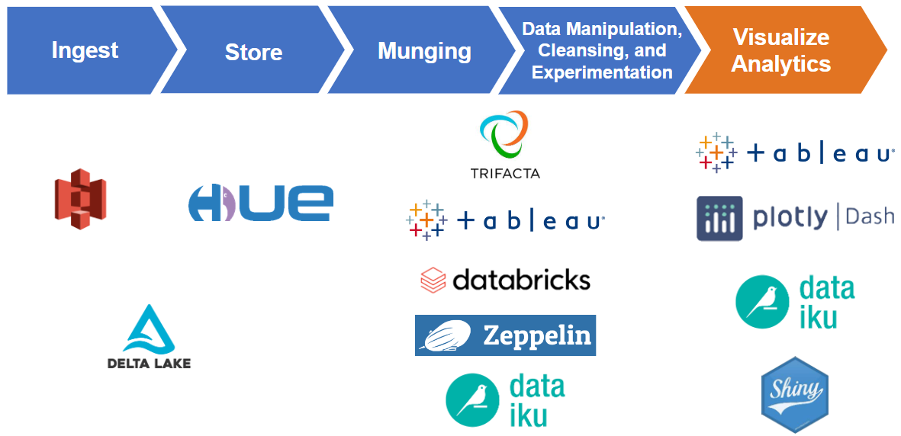
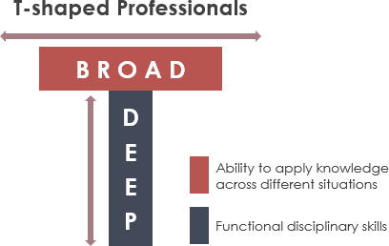

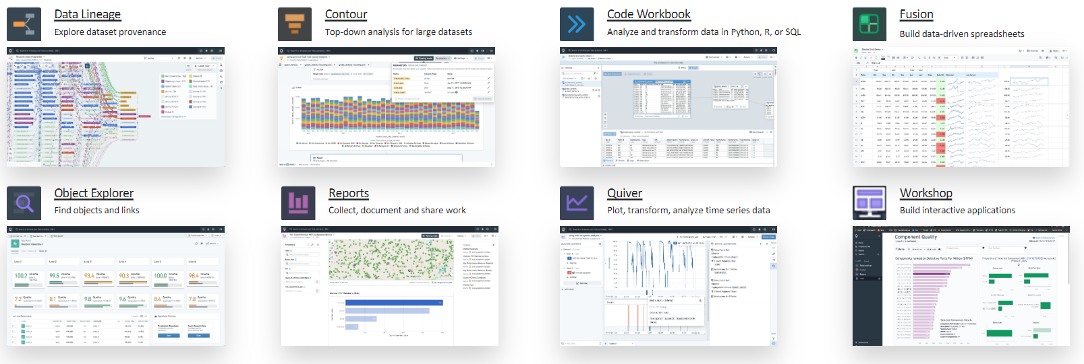

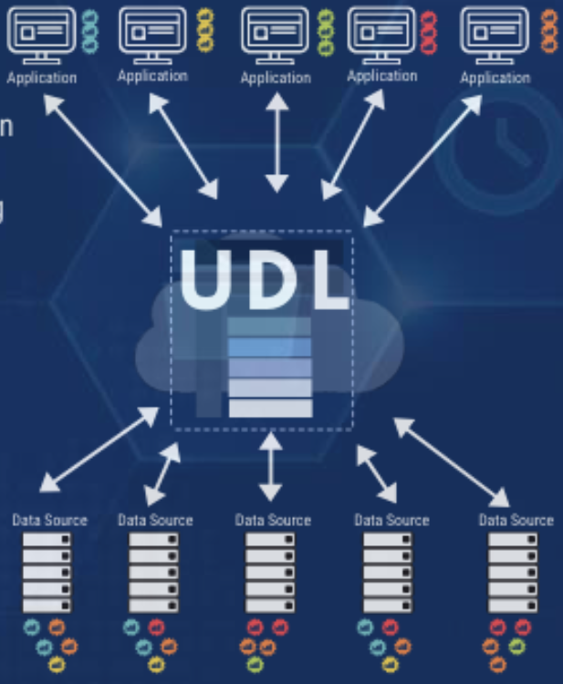
Data Hackathons: Jumpstarting Your Test Organization’s Digital Transformation
Nathan Cook | Capt Troy Soileau | Maj Matthew McCormack
96th Operations Group | 96th Cyberspace Group | USAF Test Pilot School
Air Force Test Center (AFTC) Department of the Air Force | Air Force Test Center Department of the Air Force
GitHub Pages Site for Full Paper
GitHub Site for Quarto .qmd
OBJECTIVES
EXPLORE
EXPOSE
EVOLVE
EXPAND
Solve real AFTC data problems
Discover and develop AFTC organic data talent
Drive progress in availability & AFTC use of contemporary data technologies
infrastructure
organic talent to data
to solve real problems
awareness
AFTC Data Hackathons to Date
NH-IV
GS-15
GS-14
Organic Talent
FRAMEWORK
Nov 2021 | v01.00
WHERE
Locations
Military
Civil Service
DoD Contractor
WHO
Mar 2022 | v2022-1
Roles and Responsibilities
Hacker
Problem Owner
Judge
Director
Lead Software Officer
Site Lead
Solution Development Support
Mission/Data Solution Integration Lead
Aug 2022 | v2022-2
HOW
Nov 2022 | v2022-3
Problem Definition
Registration & Approval
Collaboration Environment
LESSONS LEARNED
Feb 2023 | v2023-1
TEAM FORMATION
WHEN
Provide problem information prior to event
Allow for “first draft” team assignments
Timeline
May 2023 | v2023-2
JUDGING
Consider how awards align with organizational goals
Depending on scope allow for judge familiarization with problems
Debrief and adjust scoring rubrics every event
Aug 2023 | v2023-3
TRANSITION FROM PROTOTYPE TO PRODUCTION
Bridging the gap from event to real impact is an inherent issue
Explicitly address post-event actions
Encourage Problem Owner to provide at least one hacker from the unit
Nov 2023 | v2023-4
Disclaimer
Any mention of specific vendors, platforms, or tools is factual history of their use, and in no way an endorsement by the authors, the Department of the Air Force, the United States Government, or a sponsorship of the vendors, platforms, or tools themselves.
DISTRIBUTION STATEMENT A. Approved for public release: distribution unlimited. 96TW-2022-0053

Slide 2
Data Hackathons: Jumpstarting Your Test Organization’s Digital Transformation
Nathan Cook | Capt Troy Soileau | Maj Matthew McCormack
96th Operations Group | 96th Cyberspace Group | USAF Test Pilot School
Air Force Test Center (AFTC) Department of the Air Force | Air Force Test Center Department of the Air Force
Disclaimer
Any mention of specific vendors, platforms, or tools is factual history of their use, and in no way an endorsement by the authors, the Department of the Air Force, the United States Government, or a sponsorship of the vendors, platforms, or tools themselves.
GitHub Pages Site for Full Paper
DISTRIBUTION STATEMENT A. Approved for public release: distribution unlimited. 96TW-2022-0053
GitHub Site for Quarto .qmd

Slide 3
Data Hackathons: Jumpstarting Your Test Organization’s Digital Transformation
Nathan Cook | Capt Troy Soileau | Maj Matthew McCormack
96th Operations Group | 96th Cyberspace Group | USAF Test Pilot School
Air Force Test Center (AFTC) Department of the Air Force | Air Force Test Center Department of the Air Force
GitHub Pages Site for Full Paper
GitHub Site for Quarto .qmd
Nov 2021 | v01.00
Mar 2022 | v2022-1
Aug 2022 | v2022-2
Nov 2022 | v2022-3
OBJECTIVES
Feb 2023 | v2023-1
Solve real AFTC data problems
Discover and develop AFTC organic data talent
Drive progress in availability & AFTC use of contemporary data technologies
May 2023 | v2023-2
Aug 2023 | v2023-3
Nov 2023 | v2023-4
Disclaimer
Any mention of specific vendors, platforms, or tools is factual history of their use, and in no way an endorsement by the authors, the Department of the Air Force, the United States Government, or a sponsorship of the vendors, platforms, or tools themselves.
DISTRIBUTION STATEMENT A. Approved for public release: distribution unlimited. 96TW-2022-0053

Slide 4
Data Hackathons: Jumpstarting Your Test Organization’s Digital Transformation
Nathan Cook | Capt Troy Soileau | Maj Matthew McCormack
96th Operations Group | 96th Cyberspace Group | USAF Test Pilot School
Air Force Test Center (AFTC) Department of the Air Force | Air Force Test Center Department of the Air Force
EXPLORE
infrastructure
GitHub Pages Site for Full Paper
GitHub Site for Quarto .qmd
OBJECTIVES
Solve real AFTC data problems
Discover and develop AFTC organic data talent
Drive progress in availability & AFTC use of contemporary data technologies
AFTC Data Hackathons to Date
Nov 2021 | v01.00
Mar 2022 | v2022-1
Aug 2022 | v2022-2
Nov 2022 | v2022-3
Feb 2023 | v2023-1
May 2023 | v2023-2
Aug 2023 | v2023-3
Nov 2023 | v2023-4
Disclaimer
Any mention of specific vendors, platforms, or tools is factual history of their use, and in no way an endorsement by the authors, the Department of the Air Force, the United States Government, or a sponsorship of the vendors, platforms, or tools themselves.
DISTRIBUTION STATEMENT A. Approved for public release: distribution unlimited. 96TW-2022-0053

Slide 5
Data Hackathons: Jumpstarting Your Test Organization’s Digital Transformation
Nathan Cook | Capt Troy Soileau | Maj Matthew McCormack
96th Operations Group | 96th Cyberspace Group | USAF Test Pilot School
Air Force Test Center (AFTC) Department of the Air Force | Air Force Test Center Department of the Air Force
EXPLORE
infrastructure
GitHub Pages Site for Full Paper
GitHub Site for Quarto .qmd
OBJECTIVES
Solve real AFTC data problems
Discover and develop AFTC organic data talent
Drive progress in availability & AFTC use of contemporary data technologies
AFTC Data Hackathons to Date
Nov 2021 | v01.00
Mar 2022 | v2022-1
Aug 2022 | v2022-2
Nov 2022 | v2022-3
Feb 2023 | v2023-1
May 2023 | v2023-2
Aug 2023 | v2023-3
Nov 2023 | v2023-4
Disclaimer
Any mention of specific vendors, platforms, or tools is factual history of their use, and in no way an endorsement by the authors, the Department of the Air Force, the United States Government, or a sponsorship of the vendors, platforms, or tools themselves.
DISTRIBUTION STATEMENT A. Approved for public release: distribution unlimited. 96TW-2022-0053

Slide 6
Data Hackathons: Jumpstarting Your Test Organization’s Digital Transformation
Nathan Cook | Capt Troy Soileau | Maj Matthew McCormack
96th Operations Group | 96th Cyberspace Group | USAF Test Pilot School
Air Force Test Center (AFTC) Department of the Air Force | Air Force Test Center Department of the Air Force
EXPLORE
infrastructure
GitHub Pages Site for Full Paper
GitHub Site for Quarto .qmd
OBJECTIVES
Solve real AFTC data problems
Discover and develop AFTC organic data talent
Drive progress in availability & AFTC use of contemporary data technologies
AFTC Data Hackathons to Date
Nov 2021 | v01.00
Mar 2022 | v2022-1
Aug 2022 | v2022-2
Nov 2022 | v2022-3
Feb 2023 | v2023-1
May 2023 | v2023-2
Aug 2023 | v2023-3
Nov 2023 | v2023-4
Disclaimer
Any mention of specific vendors, platforms, or tools is factual history of their use, and in no way an endorsement by the authors, the Department of the Air Force, the United States Government, or a sponsorship of the vendors, platforms, or tools themselves.
DISTRIBUTION STATEMENT A. Approved for public release: distribution unlimited. 96TW-2022-0053

Slide 7
Data Hackathons: Jumpstarting Your Test Organization’s Digital Transformation
Nathan Cook | Capt Troy Soileau | Maj Matthew McCormack
96th Operations Group | 96th Cyberspace Group | USAF Test Pilot School
Air Force Test Center (AFTC) Department of the Air Force | Air Force Test Center Department of the Air Force
EXPLORE
infrastructure
GitHub Pages Site for Full Paper
GitHub Site for Quarto .qmd
OBJECTIVES
Solve real AFTC data problems
Discover and develop AFTC organic data talent
Drive progress in availability & AFTC use of contemporary data technologies
AFTC Data Hackathons to Date
Nov 2021 | v01.00
Mar 2022 | v2022-1
Aug 2022 | v2022-2
Nov 2022 | v2022-3
Feb 2023 | v2023-1
May 2023 | v2023-2
Aug 2023 | v2023-3
Nov 2023 | v2023-4

Slide 8
Data Hackathons: Jumpstarting Your Test Organization’s Digital Transformation
Nathan Cook | Capt Troy Soileau | Maj Matthew McCormack
96th Operations Group | 96th Cyberspace Group | USAF Test Pilot School
Air Force Test Center (AFTC) Department of the Air Force | Air Force Test Center Department of the Air Force
EXPLORE
infrastructure
GitHub Pages Site for Full Paper
GitHub Site for Quarto .qmd
OBJECTIVES
Solve real AFTC data problems
Discover and develop AFTC organic data talent
Drive progress in availability & AFTC use of contemporary data technologies
AFTC Data Hackathons to Date
Nov 2021 | v01.00
Mar 2022 | v2022-1
Aug 2022 | v2022-2
Nov 2022 | v2022-3
Feb 2023 | v2023-1
May 2023 | v2023-2
Aug 2023 | v2023-3
Nov 2023 | v2023-4

Slide 9
Data Hackathons: Jumpstarting Your Test Organization’s Digital Transformation
Nathan Cook | Capt Troy Soileau | Maj Matthew McCormack
96th Operations Group | 96th Cyberspace Group | USAF Test Pilot School
Air Force Test Center (AFTC) Department of the Air Force | Air Force Test Center Department of the Air Force
EXPOSE
organic talent to data
GitHub Pages Site for Full Paper
GitHub Site for Quarto .qmd
OBJECTIVES
EXPLORE
Solve real AFTC data problems
Discover and develop AFTC organic data talent
Drive progress in availability & AFTC use of contemporary data technologies
infrastructure
AFTC Data Hackathons to Date
Nov 2021 | v01.00
Mar 2022 | v2022-1
Aug 2022 | v2022-2
Nov 2022 | v2022-3
Feb 2023 | v2023-1
May 2023 | v2023-2
Aug 2023 | v2023-3
Nov 2023 | v2023-4
Disclaimer
Any mention of specific vendors, platforms, or tools is factual history of their use, and in no way an endorsement by the authors, the Department of the Air Force, the United States Government, or a sponsorship of the vendors, platforms, or tools themselves.
DISTRIBUTION STATEMENT A. Approved for public release: distribution unlimited. 96TW-2022-0053

Slide 10
Data Hackathons: Jumpstarting Your Test Organization’s Digital Transformation
Nathan Cook | Capt Troy Soileau | Maj Matthew McCormack
96th Operations Group | 96th Cyberspace Group | USAF Test Pilot School
Air Force Test Center (AFTC) Department of the Air Force | Air Force Test Center Department of the Air Force
EXPOSE
organic talent to data
GitHub Pages Site for Full Paper
GitHub Site for Quarto .qmd
OBJECTIVES
EXPLORE
Solve real AFTC data problems
Discover and develop AFTC organic data talent
Drive progress in availability & AFTC use of contemporary data technologies
infrastructure
Organic Talent
AFTC Data Hackathons to Date
Nov 2021 | v01.00
Mar 2022 | v2022-1
Aug 2022 | v2022-2
Nov 2022 | v2022-3
Feb 2023 | v2023-1
May 2023 | v2023-2
Military
Civil Service
DoD Contractor
Aug 2023 | v2023-3
Nov 2023 | v2023-4
Disclaimer
Any mention of specific vendors, platforms, or tools is factual history of their use, and in no way an endorsement by the authors, the Department of the Air Force, the United States Government, or a sponsorship of the vendors, platforms, or tools themselves.
DISTRIBUTION STATEMENT A. Approved for public release: distribution unlimited. 96TW-2022-0053

Slide 11
Data Hackathons: Jumpstarting Your Test Organization’s Digital Transformation
Nathan Cook | Capt Troy Soileau | Maj Matthew McCormack
96th Operations Group | 96th Cyberspace Group | USAF Test Pilot School
Air Force Test Center (AFTC) Department of the Air Force | Air Force Test Center Department of the Air Force
EXPOSE
organic talent to data
Organic Talent
GitHub Pages Site for Full Paper
GitHub Site for Quarto .qmd
OBJECTIVES
EXPLORE
Solve real AFTC data problems
Discover and develop AFTC organic data talent
Drive progress in availability & AFTC use of contemporary data technologies
infrastructure
Military
Civil Service
DoD Contractor
AFTC Data Hackathons to Date
Nov 2021 | v01.00
Mar 2022 | v2022-1
Aug 2022 | v2022-2
Nov 2022 | v2022-3
Feb 2023 | v2023-1
May 2023 | v2023-2
Aug 2023 | v2023-3
Nov 2023 | v2023-4
Disclaimer
Any mention of specific vendors, platforms, or tools is factual history of their use, and in no way an endorsement by the authors, the Department of the Air Force, the United States Government, or a sponsorship of the vendors, platforms, or tools themselves.
DISTRIBUTION STATEMENT A. Approved for public release: distribution unlimited. 96TW-2022-0053

Slide 12
Data Hackathons: Jumpstarting Your Test Organization’s Digital Transformation
Nathan Cook | Capt Troy Soileau | Maj Matthew McCormack
96th Operations Group | 96th Cyberspace Group | USAF Test Pilot School
Air Force Test Center (AFTC) Department of the Air Force | Air Force Test Center Department of the Air Force
EVOLVE
to solve real problems
GitHub Pages Site for Full Paper
GitHub Site for Quarto .qmd
OBJECTIVES
EXPLORE
EXPOSE
Solve real AFTC data problems
Discover and develop AFTC organic data talent
Drive progress in availability & AFTC use of contemporary data technologies
infrastructure
organic talent to data
AFTC Data Hackathons to Date
Organic Talent
Nov 2021 | v01.00
Military
Civil Service
DoD Contractor
Mar 2022 | v2022-1
Aug 2022 | v2022-2
Nov 2022 | v2022-3
Feb 2023 | v2023-1
May 2023 | v2023-2
Aug 2023 | v2023-3
Nov 2023 | v2023-4
Disclaimer
Any mention of specific vendors, platforms, or tools is factual history of their use, and in no way an endorsement by the authors, the Department of the Air Force, the United States Government, or a sponsorship of the vendors, platforms, or tools themselves.
DISTRIBUTION STATEMENT A. Approved for public release: distribution unlimited. 96TW-2022-0053

Slide 13
Data Hackathons: Jumpstarting Your Test Organization’s Digital Transformation
Nathan Cook | Capt Troy Soileau | Maj Matthew McCormack
96th Operations Group | 96th Cyberspace Group | USAF Test Pilot School
Air Force Test Center (AFTC) Department of the Air Force | Air Force Test Center Department of the Air Force
EXPAND
awareness
GitHub Pages Site for Full Paper
GitHub Site for Quarto .qmd
OBJECTIVES
EXPLORE
EXPOSE
EVOLVE
Solve real AFTC data problems
Discover and develop AFTC organic data talent
Drive progress in availability & AFTC use of contemporary data technologies
infrastructure
organic talent to data
to solve real problems
AFTC Data Hackathons to Date
GS-15
NH-IV
Organic Talent
GS-14
Nov 2021 | v01.00
Military
Civil Service
DoD Contractor
Mar 2022 | v2022-1
Aug 2022 | v2022-2
Nov 2022 | v2022-3
Feb 2023 | v2023-1
May 2023 | v2023-2
Aug 2023 | v2023-3
Nov 2023 | v2023-4
Disclaimer
Any mention of specific vendors, platforms, or tools is factual history of their use, and in no way an endorsement by the authors, the Department of the Air Force, the United States Government, or a sponsorship of the vendors, platforms, or tools themselves.
DISTRIBUTION STATEMENT A. Approved for public release: distribution unlimited. 96TW-2022-0053

Slide 14
Data Hackathons: Jumpstarting Your Test Organization’s Digital Transformation
Nathan Cook | Capt Troy Soileau | Maj Matthew McCormack
96th Operations Group | 96th Cyberspace Group | USAF Test Pilot School
Air Force Test Center (AFTC) Department of the Air Force | Air Force Test Center Department of the Air Force
FRAMEWORK
WHERE
GitHub Pages Site for Full Paper
GitHub Site for Quarto .qmd
Locations
OBJECTIVES
EXPLORE
EXPOSE
EVOLVE
EXPAND
Solve real AFTC data problems
Discover and develop AFTC organic data talent
Drive progress in availability & AFTC use of contemporary data technologies
infrastructure
organic talent to data
to solve real problems
awareness
WHO
AFTC Data Hackathons to Date
Roles and Responsibilities
NH-IV
GS-15
Hacker
Problem Owner
Judge
Director
Lead Software Officer
Site Lead
Solution Development Support
Mission/Data Solution Integration Lead
GS-14
Organic Talent
Nov 2021 | v01.00
Military
Civil Service
DoD Contractor
Mar 2022 | v2022-1
Aug 2022 | v2022-2
HOW
Nov 2022 | v2022-3
Problem Definition
Registration & Approval
Collaboration Environment
Feb 2023 | v2023-1
May 2023 | v2023-2
WHEN
Aug 2023 | v2023-3
Timeline
Nov 2023 | v2023-4
Disclaimer
Any mention of specific vendors, platforms, or tools is factual history of their use, and in no way an endorsement by the authors, the Department of the Air Force, the United States Government, or a sponsorship of the vendors, platforms, or tools themselves.
DISTRIBUTION STATEMENT A. Approved for public release: distribution unlimited. 96TW-2022-0053

Slide 15
Data Hackathons: Jumpstarting Your Test Organization’s Digital Transformation
Nathan Cook | Capt Troy Soileau | Maj Matthew McCormack
96th Operations Group | 96th Cyberspace Group | USAF Test Pilot School
Air Force Test Center (AFTC) Department of the Air Force | Air Force Test Center Department of the Air Force
LESSONS LEARNED
TEAM FORMATION
GitHub Pages Site for Full Paper
GitHub Site for Quarto .qmd
Provide problem information prior to event
Allow for “first draft” team assignments
OBJECTIVES
EXPLORE
EXPOSE
EVOLVE
EXPAND
Solve real AFTC data problems
Discover and develop AFTC organic data talent
Drive progress in availability & AFTC use of contemporary data technologies
infrastructure
organic talent to data
to solve real problems
awareness
AFTC Data Hackathons to Date
JUDGING
NH-IV
GS-15
GS-14
Consider how awards align with organizational goals
Depending on scope allow for judge familiarization with problems
Debrief and adjust scoring rubrics every event
Organic Talent
FRAMEWORK
Nov 2021 | v01.00
WHERE
Locations
Military
Civil Service
DoD Contractor
WHO
Mar 2022 | v2022-1
Roles and Responsibilities
Hacker
Problem Owner
Judge
Director
Lead Software Officer
Site Lead
Solution Development Support
Mission/Data Solution Integration Lead
TRANSITION FROM PROTOTYPE TO PRODUCTION
Bridging the gap from event to real impact is an inherent issue
Explicitly address post-event actions
Encourage Problem Owner to provide at least one hacker from the unit
Aug 2022 | v2022-2
HOW
Nov 2022 | v2022-3
Problem Definition
Registration & Approval
Collaboration Environment
Feb 2023 | v2023-1
WHEN
Timeline
May 2023 | v2023-2
Aug 2023 | v2023-3
Nov 2023 | v2023-4
Disclaimer
Any mention of specific vendors, platforms, or tools is factual history of their use, and in no way an endorsement by the authors, the Department of the Air Force, the United States Government, or a sponsorship of the vendors, platforms, or tools themselves.
DISTRIBUTION STATEMENT A. Approved for public release: distribution unlimited. 96TW-2022-0053

Slide 16
Data Hackathons: Jumpstarting Your Test Organization’s Digital Transformation
Nathan Cook | Capt Troy Soileau | Maj Matthew McCormack
96th Operations Group | 96th Cyberspace Group | USAF Test Pilot School
Air Force Test Center (AFTC) Department of the Air Force | Air Force Test Center Department of the Air Force
GitHub Pages Site for Full Paper
GitHub Site for Quarto .qmd
OBJECTIVES
EXPLORE
EXPOSE
EVOLVE
EXPAND
Solve real AFTC data problems
Discover and develop AFTC organic data talent
Drive progress in availability & AFTC use of contemporary data technologies
infrastructure
organic talent to data
to solve real problems
awareness
AFTC Data Hackathons to Date
NH-IV
GS-15
GS-14
Organic Talent
FRAMEWORK
Nov 2021 | v01.00
WHERE
Locations
Military
Civil Service
DoD Contractor
WHO
Mar 2022 | v2022-1
Roles and Responsibilities
Hacker
Problem Owner
Judge
Director
Lead Software Officer
Site Lead
Solution Development Support
Mission/Data Solution Integration Lead
Aug 2022 | v2022-2
HOW
Nov 2022 | v2022-3
Problem Definition
Registration & Approval
Collaboration Environment
LESSONS LEARNED
Feb 2023 | v2023-1
TEAM FORMATION
WHEN
Provide problem information prior to event
Allow for “first draft” team assignments
Timeline
May 2023 | v2023-2
JUDGING
Consider how awards align with organizational goals
Depending on scope allow for judge familiarization with problems
Debrief and adjust scoring rubrics every event
Aug 2023 | v2023-3
TRANSITION FROM PROTOTYPE TO PRODUCTION
Bridging the gap from event to real impact is an inherent issue
Explicitly address post-event actions
Encourage Problem Owner to provide at least one hacker from the unit
Nov 2023 | v2023-4
Disclaimer
Any mention of specific vendors, platforms, or tools is factual history of their use, and in no way an endorsement by the authors, the Department of the Air Force, the United States Government, or a sponsorship of the vendors, platforms, or tools themselves.
DISTRIBUTION STATEMENT A. Approved for public release: distribution unlimited. 96TW-2022-0053

